Slide 1

BOARD OF DIRECTORS — Q2 FY25 REVIEW
Board
Meeting.
Performance against plan, strategic progress, top risks,
and three decisions we're asking the board to approve
today.
DATE
STAGE
CLASSIFICATION
May 14, 2025
Series B
Confidential

Slide 2

SESSION OVERVIEW
DURATION
Agenda
90 min
01
KPIs vs plan — ARR, NRR, pipeline
18 MIN
02
Financials, budget vs actual & runway
16 MIN
03
Strategic priorities for the half
14 MIN
04
Top three risks & mitigations
14 MIN
05
Decisions to approve
22 MIN
BOARD DECK — Q2 FY25
02 / 10

Slide 3
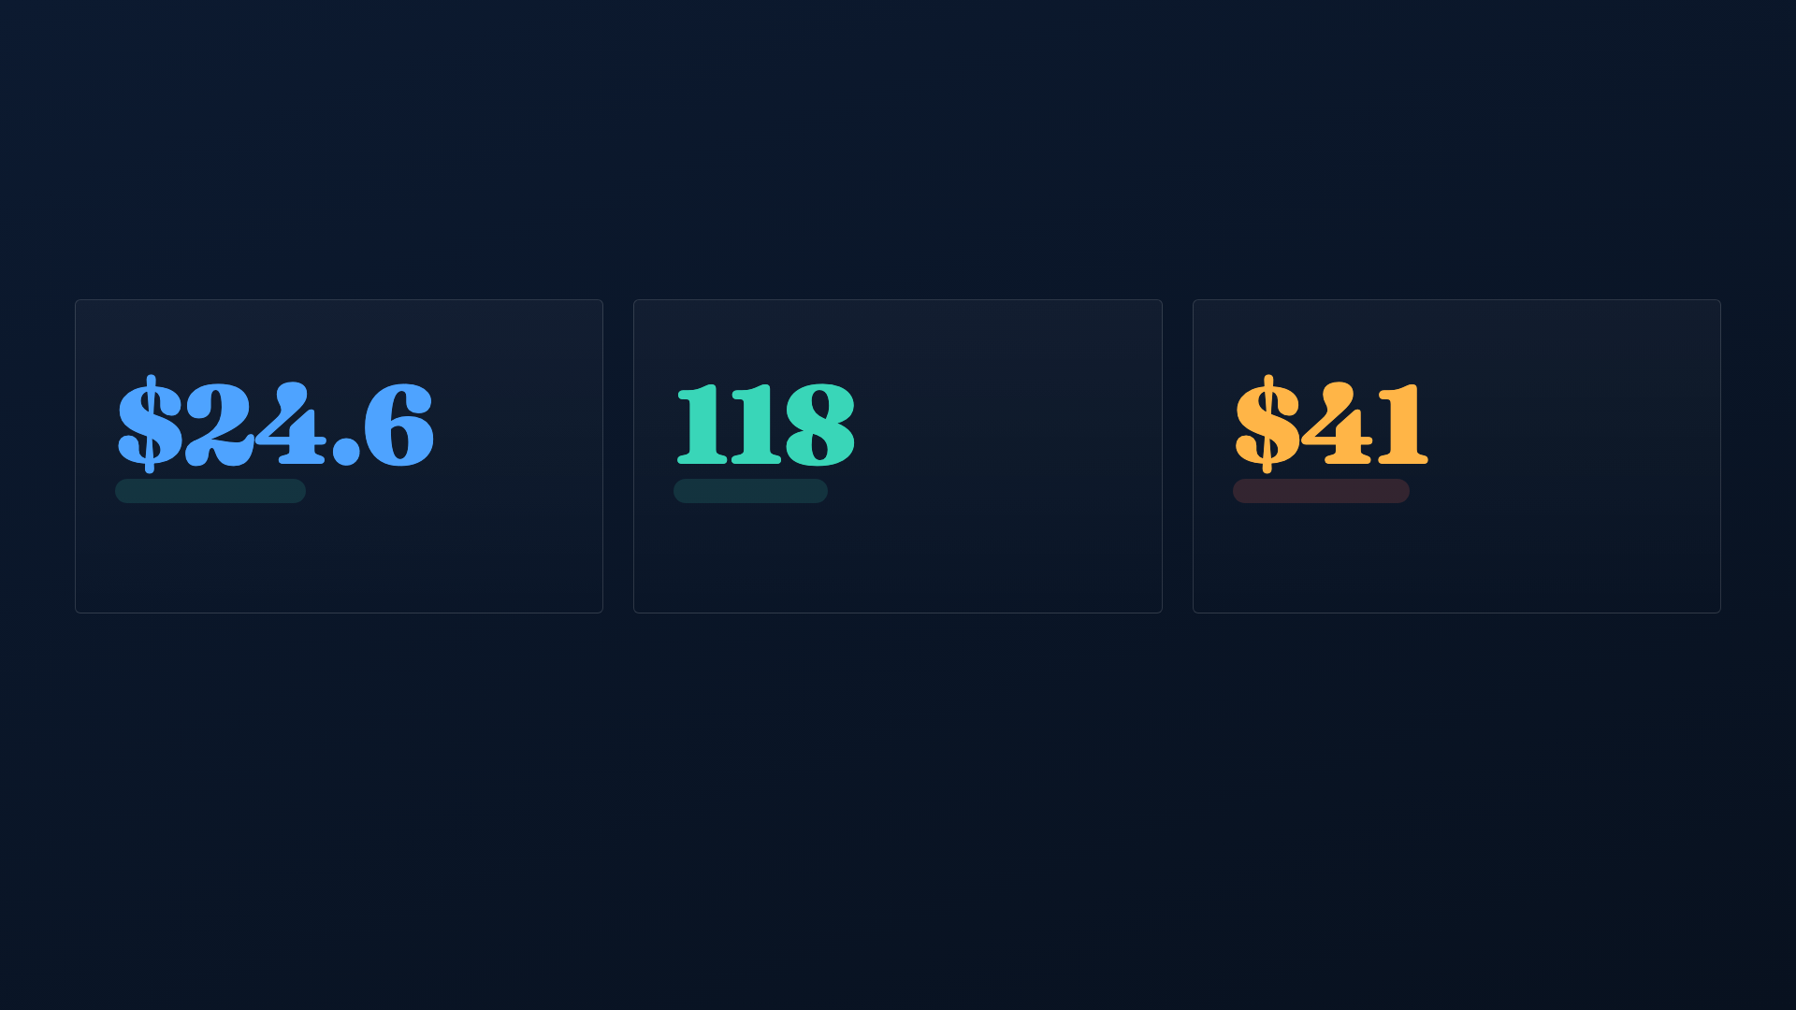
SECTION 01 — PERFORMANCE
QUARTER ENDING MAR 31, 2025
KPIs against plan
ENDING ARR
NET REVENUE RETENTION
QUALIFIED PIPELINE
M
%
M
▲ 4% AHEAD OF PLAN
▲ 6 PTS VS PLAN
▼ 12% BEHIND PLAN
Plan was $23.7M. Net new ARR of $3.1M, driven by upsell
Gross churn held at 7%. Expansion strong; land-and-
Coverage at 2.8× vs 3.2× target. Top-of-funnel softness is
into the enterprise cohort.
expand motion outperforming target.
the key concern this half.
BOARD DECK — Q2 FY25
03 / 10

Slide 4
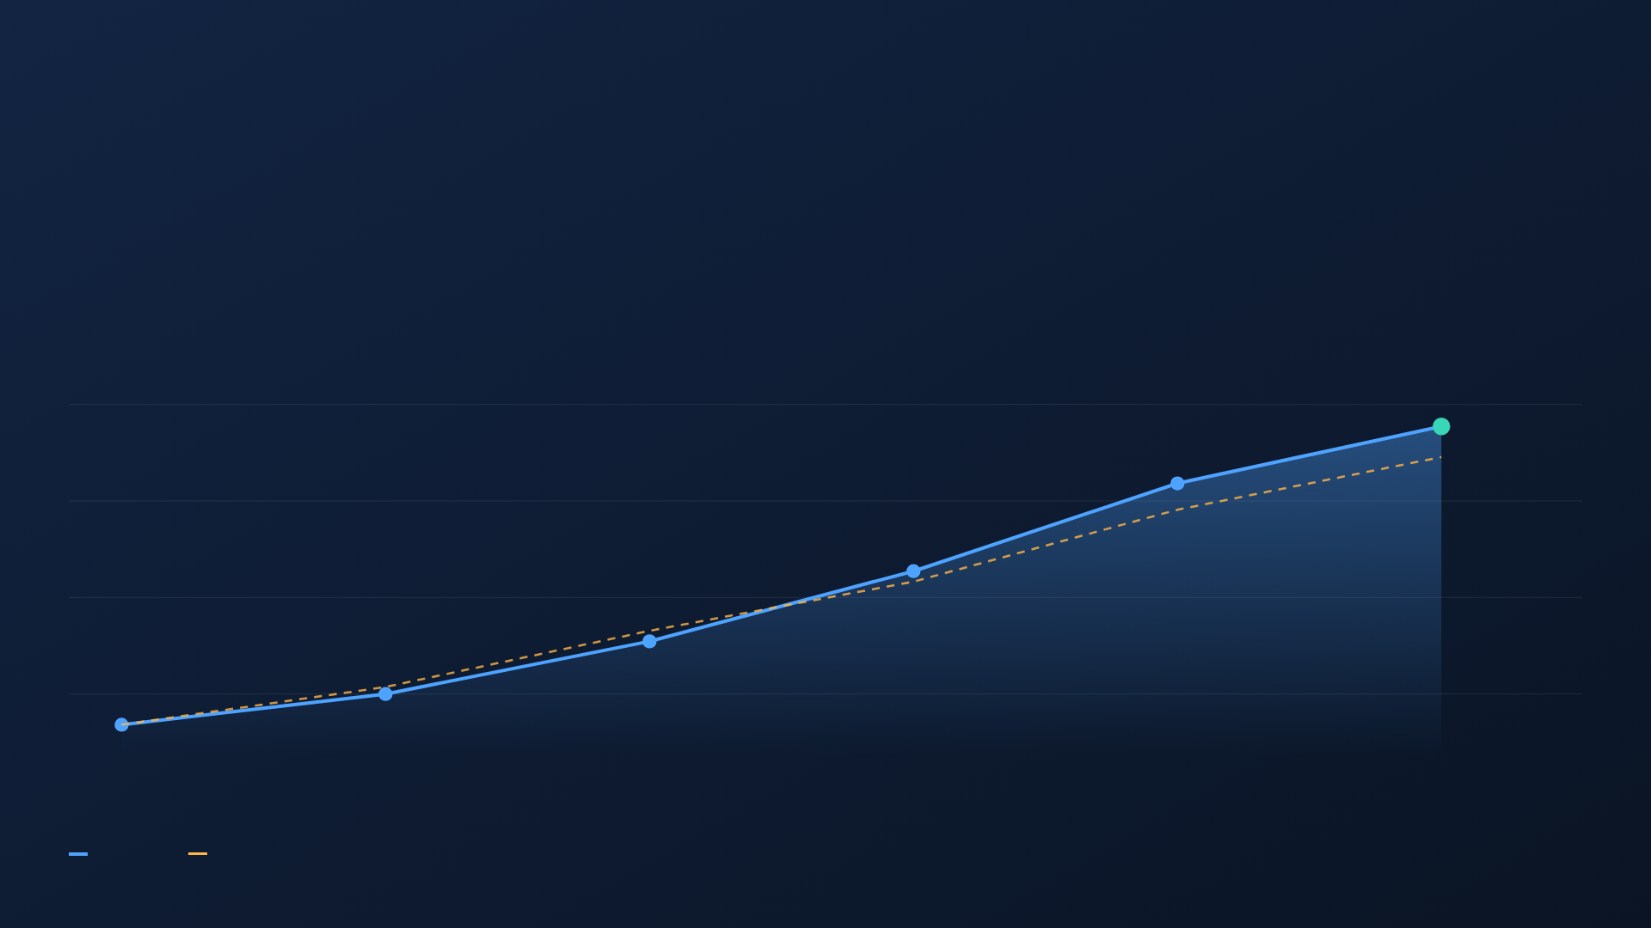
ARR TRAJECTORY
+61%
Six quarters of
compounding
YOY ARR GROWTH
growth
Q1'24 · $15.3M
Q2'24
Q3'24
Q4'24
Q1'25
Q2'25 · $24.6M
Actual ARR
Board plan
BOARD DECK — Q2 FY25
04 / 10

Slide 5

SECTION 02 — FINANCIALS
Budget vs actual
$000S — Q2 FY25
PLAN
ACTUAL
VARIANCE
CASH POSITION
Revenue (recognized)
5,780
6,010
+230
$38.4
Gross margin
78%
79%
+1 pt
M
Sales & Marketing
3,100
3,340
+240
Cash on hand as of Mar 31
Research & Development
2,450
2,390
−60
General & Admin
1,180
1,210
+30
19
mo
Net burn
2,120
2,280
+160
Runway at current burn
−2 MO VS PLAN
Elevated S&M spend shortens runway. Reforecast (Decision 1)
restores buffer to 22 months.
BOARD DECK — Q2 FY25
05 / 10

Slide 6

SECTION 03 — STRATEGY
Priorities for H2
Three bets that decide whether we exit the year at a
$30M ARR run-rate and default-alive.
01
02
03
Rebuild the top of funnel
Ship the AI insights layer
Move upmarket,
Shift budget from paid to partner-sourced pipeline.
GA in Q3. Anchors the new pricing tier and defends
deliberately
Target 3.2× coverage by Q4.
NRR against competitive pressure.
Land 8 enterprise logos at >$150K ACV. Requires the
OWNER — CRO
OWNER — CPO
VP Enterprise Sales hire (Decision 2).
OWNER — CEO
BOARD DECK — Q2 FY25
06 / 10

Slide 7

SECTION 04 — RISK
Top three risks
1
Pipeline coverage shortfall
Mitigation:
Reallocate $600K to partner channel; weekly pipeline council; SDR ramp
pulled forward.
HIGH · LIKELY
2.8× vs 3.2× target threatens H2 bookings.
2
Runway compression
Mitigation:
Reforecast (Decision 1) trims $1.4M discretionary spend, restoring 22-
month buffer.
MEDIUM · POSSIBLE
Burn 8% over plan; runway at 19 months.
3
Competitive AI feature gap
Mitigation:
AI insights layer GA in Q3; design partners under NDA; roadmap
protected from cuts.
MEDIUM · LIKELY
Two rivals shipped insight automation.
BOARD DECK — Q2 FY25
07 / 10

Slide 8

SECTION 05 — APPROVALS
Three decisions
We are requesting formal approval on each
item today. Detail follows on the next page.
for the board
DECISION 01
DECISION 02
DECISION 03
Budget reforecast
VP Enterprise Sales
Pricing change
Trim $1.4M discretionary spend; reallocate $600K to
Approve senior hire at $280K OTE + equity to lead the
Introduce usage-based AI tier; +12% list on enterprise
partner channel.
upmarket motion.
plans.
BOARD DECK — Q2 FY25
08 / 10

Slide 9

DECISIONS — IMPACT & ASK
What each unlocks
DECISION
FINANCIAL IMPACT
STRATEGIC UPSIDE
BOARD ASK
01 · Budget reforecast
Extends runway 19→22 mo
Redirects spend to partner-sourced pipeline
APPROVE
02 · VP Enterprise hire
+$460K fully-loaded FY cost
8 enterprise logos, +$1.2M new ARR target
APPROVE
03 · Pricing change
+$1.8M ARR uplift at steady churn
Monetizes AI layer; lifts NRR to ~122%
APPROVE
+$3.0M
Combined ARR upside from Decisions 2 & 3 by year-end —
the difference between a $27M and a $30M run-rate
exiting FY25.
BOARD DECK — Q2 FY25
09 / 10

Slide 10

SUMMARY & VOTE
Ahead on retention.
Focused on funnel.
Ready to decide.
Three approvals today keep Northwind default-alive and on a $30M run-
rate exit. We'll now move to a vote on Decisions 1–3.
NEXT BOARD MEETING
August 13, 2025
BOARD DECK — Q2 FY25 · CONFIDENTIAL
10 / 10

