Slide 1
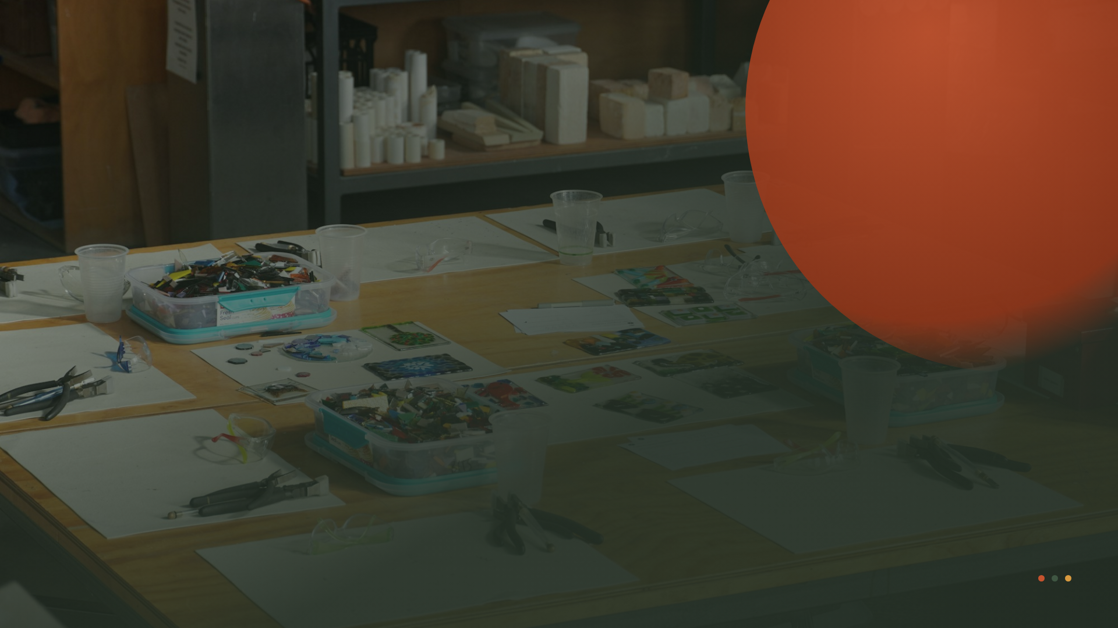
COMPANY OVERVIEW — 2025
We shape
ideas
into
things people
use.
A 40-person product design studio building digital and
physical products from first sketch to shipped release.

Slide 2
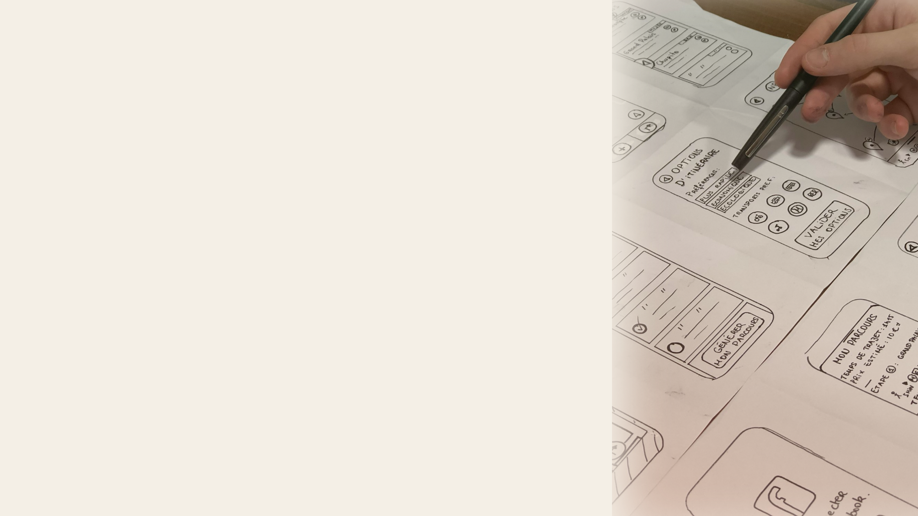
OUR MISSION
We believe good
design is
a form of
respect
— for the
person on the
other
side
of the screen.
Field & Form exists to make complex products feel obvious.
We partner with teams who care about the difference a well-
made detail makes, and we stay until the work is real — in
someone's hands, on someone's phone, working the way it
should.
FIELD & FORM STUDIO
02 / 09

Slide 3
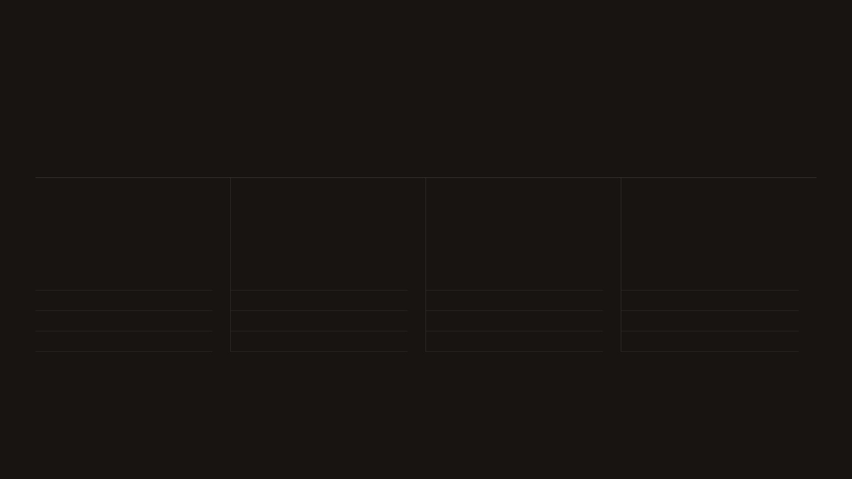
What we
do
Four practices, one integrated team. Most
engagements pull from more than one.
01
02
03
04
Product
Digital
Industrial
Brand &
Strategy
Design
Design
Motion
Discovery & research
UX / UI systems
Hardware & form
Identity systems
Roadmapping
Design systems
Prototyping
Motion & 3D
Service blueprints
Prototyping
Design for manufacture
Guidelines
Concept validation
Mobile & web
Materials & CMF
Launch assets
CAPABILITIES
03 / 09

Slide 4
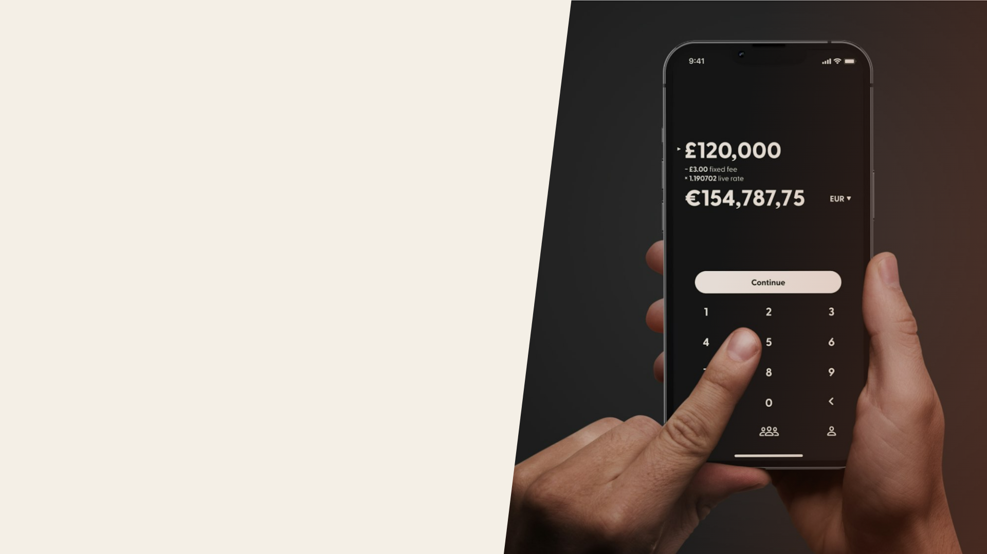
SIGNATURE PROJECT · FINTECH
Rebuilding a
bank people
actually
open.
We redesigned Alderquill's mobile banking from the
account model up — a new information architecture, a
component library, and a calmer visual language.
+63%
4.8★
DAILY ACTIVE USERS
APP STORE RATING, UP
WITHIN TWO QUARTERS
FROM 3.1
CASE STUDY — ALDERQUILL
04 / 09

Slide 5

SIGNATURE PROJECT · MOBILITY
An EV interface
that keeps eyes
on the
road.
A ground-up in-vehicle experience for Volta — hardware,
software, and voice designed as one system, tested
across 200+ real drives.
−41%
9
GLANCE TIME AWAY FROM
MARKETS SHIPPED IN
THE ROAD
FIRST YEAR
CASE STUDY — VOLTA
05 / 09

Slide 6

SIGNATURE PROJECT · HEALTH
A home device
a nurse can
trust
blind.
For Curra we designed a connected diagnostic device and
companion app — form, firmware UI, and packaging —
cleared and in patients' homes.
92%
18mo
FIRST-TRY SETUP
CONCEPT TO FICTIONAL
SUCCESS, UNASSISTED
DEMO LAUNCH
CASE STUDY — CURRA
06 / 09

Slide 7
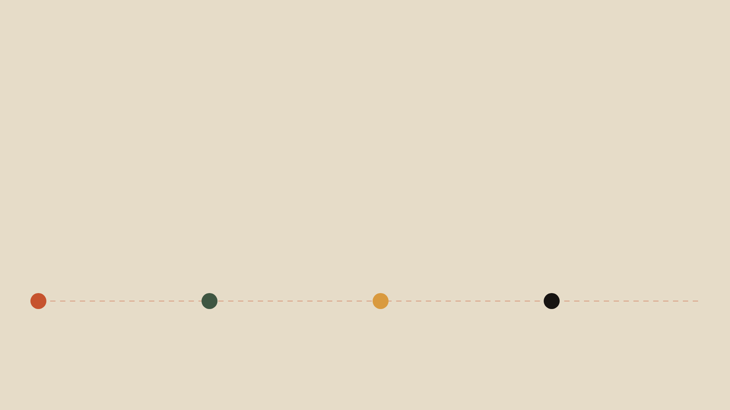
HOW WE WORK
Small teams,
tight
loops
, and a bias
toward making
things real.
1
2
3
4
Frame
Explore
Refine
Ship
Two weeks to align on the real problem,
Divergent concepts, fast prototypes,
We narrow to one direction, test with real
We embed with your engineers through
the users, and what "done" looks like
and honest critique. We show early and
people, and build a system that scales.
launch — design isn't done until it's live.
before pixels move.
often.
OUR PROCESS
07 / 09

Slide 8

THE STUDIO
Forty people
who
sweat
the details.
Strategists, designers, and engineers who sit in the
same room — flat, senior, and allergic to hand-offs that
lose intent.
14
9
Product & UX designers
Industrial designers
7
10
Design engineers
Strategy, brand & ops
OUR TEAM
08 / 09

Slide 9

hello@fieldandform.co
fieldandform.co
START A PROJECT
Let's make
something
real.
STEP ONE
STEP TWO
STEP THREE
A 30-minute call to see if
A short paid discovery to
We assemble your team and
there's a fit.
scope the work.
get to work.
FIELD & FORM STUDIO
09 / 09

