Slide 1

INVESTOR UPDATE · Q2 FY25
Steady lift,
strong tailwind.
The quarter Northwind crossed
$2.4M ARR
— and proved the enterprise
motion works.
ARR
QOQ GROWTH
RUNWAY
$2.4M
+38%
19 mo
CONFIDENTIAL — FOR EXISTING INVESTORS ONLY
01 / 09

Slide 2

TL;DR
The 30-second read
MOMENTUM
PRODUCT
ARR up
38% QoQ to $2.4M
, driven by two enterprise logos and
Shipped the
Snowflake bi-directional integration
— now live with 40%
expansion in the base. NRR held at
121%
.
of accounts and unblocking three enterprise deals.
WATCH ITEM
THE TWO ASKS
Our
VP Engineering hire slipped
a quarter. Roadmap absorbed it;
1)
Warm intros to
CFO / finance buyers
.
2)
A
senior data-engineering
hiring is now our #1 ask this update.
candidate for our founding platform role.
02 / 09

Slide 3
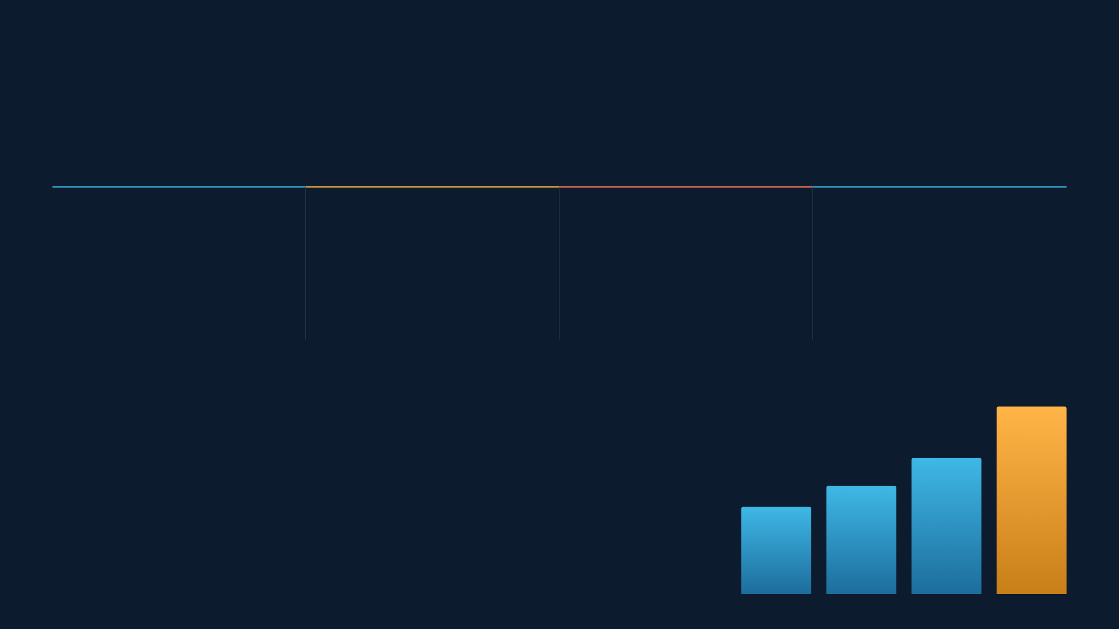
METRICS VS. Q1
Numbers that matter
ARR
NET REV. RETENTION
NET MONTHLY BURN
CASH RUNWAY
$2.4
121
$210
19
M
%
k
mo
▲ +38% QoQ
▲ +4 pts
▼ up 6% vs Q1
◆ flat, $4.0M cash
$2.4M
$1.74M
$1.4M
$1.1M
ARR TRAJECTORY
Fourth consecutive quarter of accelerating
net-new ARR. Enterprise now 44% of
book.
03 / 09
Q3'24
Q4'24
Q1'25
Q2'25

Slide 4

WINS THIS QUARTER
What went right
01
Two enterprise logos closed
Signed a Fortune-500 logistics firm and a national insurer —
combined $520k ACV, both multi-year.
+$520K ACV
02
Snowflake integration shipped
Bi-directional sync went GA on schedule. Live with 40% of accounts
inside three weeks; top-requested feature of the year.
SHIPPED ON TIME
03
NRR expanded to 121%
Seat + module expansion outpaced churn. Gross retention steady at
94%.
BEST-IN-CLASS
04 / 09

Slide 5

CANDID — WHAT SLIPPED
The honest column
1Q
DELAY ON KEY HIRE
!
Senior data-engineering hire slipped a quarter
Our final candidate for the founding VP Engineering role took a
competing offer late-stage. Search reopened; we prioritized fit over
speed. Roadmap velocity held because the platform team absorbed
critical-path work — but this remains our biggest single risk to H2
scale.
!
Burn ticked up 6%
Sales hiring ahead of pipeline pulled burn to $210k/mo. Deliberate and
covered by runway — we're watching CAC payback closely (currently
14 months).
05 / 09

Slide 6

UNIT ECONOMICS
The engine is compounding
GROSS MARGIN
CAC PAYBACK
MAGIC NUMBER
82
14
1.3
%
mo
Enterprise 44%
Mid-market 34%
SMB 22%
Every dollar into sales returns
$1.30
of net-new ARR within a year. The
enterprise shift is lifting deal size and margin simultaneously.
06 / 09

Slide 7

Grow
Build
Fix
Close 3 enterprise deals now in late-stage pipeline
Ship real-time alerting + anomaly detection
Close the VP Engineering / senior data hire (top
($900k ACV)
priority)
Second integration: Databricks connector
Launch CFO-focused finance analytics package
Bring CAC payback under 12 months
SOC 2 Type II certification complete
Push toward $3M ARR exit rate
Formalize enterprise onboarding playbook
07 / 09

Slide 8

HOW YOU CAN HELP
Two specific asks
01
02
INTROS
HIRING
CFO & finance
Senior data
buyers
engineer
Our new finance package needs design partners. We're looking for warm intros to
CFOs or VP
Founding platform role — someone who's built
high-throughput data pipelines
at scale (Snowflake /
Finance
at 500–5,000-person companies. Two intros this quarter would meaningfully de-risk Q3
Spark / Kafka). Know someone great? A single referral could close our biggest gap.
pipeline.
Reply to this thread or grab time →
founders@northwind.io
08 / 09

Slide 9

IN CLOSING
Building through
the noise.
A clean quarter of compounding growth, honest about the hire we
missed. Thank you for the support — the asks above are how you
can help us make Q3 our best yet.
ARR
RUNWAY
NEXT UPDATE
$2.4M
19 mo
Oct
09 / 09

