Slide 1

Cadence
Q3 2025 · GO-TO-MARKET PLAN
Ship the
plan.
*
The launch strategy for Cadence — the project-management
app that keeps teams in rhythm. Goals, segments, channels,
calendar, budget and the metrics that prove it worked.
* ONE DOMINANT METRIC PER PHASE — NO VANITY NUMBERS
CADENCE
MARKETING · CONFIDENTIAL
01 / 11

Slide 2

THE BET · WHY THIS LAUNCH MATTERS
Teams don't need
another tool.
$9.7B
They need a rhythm.
The PM category is crowded and fatigued — the average
PM software market, 2025 — growing 13% YoY
knowledge worker juggles 9 apps a day. We don't win on features.
We win on the promise that Cadence makes coordination feel
effortless. Every dollar this quarter buys that story.
61%
of teams say their tools slow them down
12wk
to establish share of voice before Q4 budgets
CADENCE
THE OPPORTUNITY
02 / 11

Slide 3
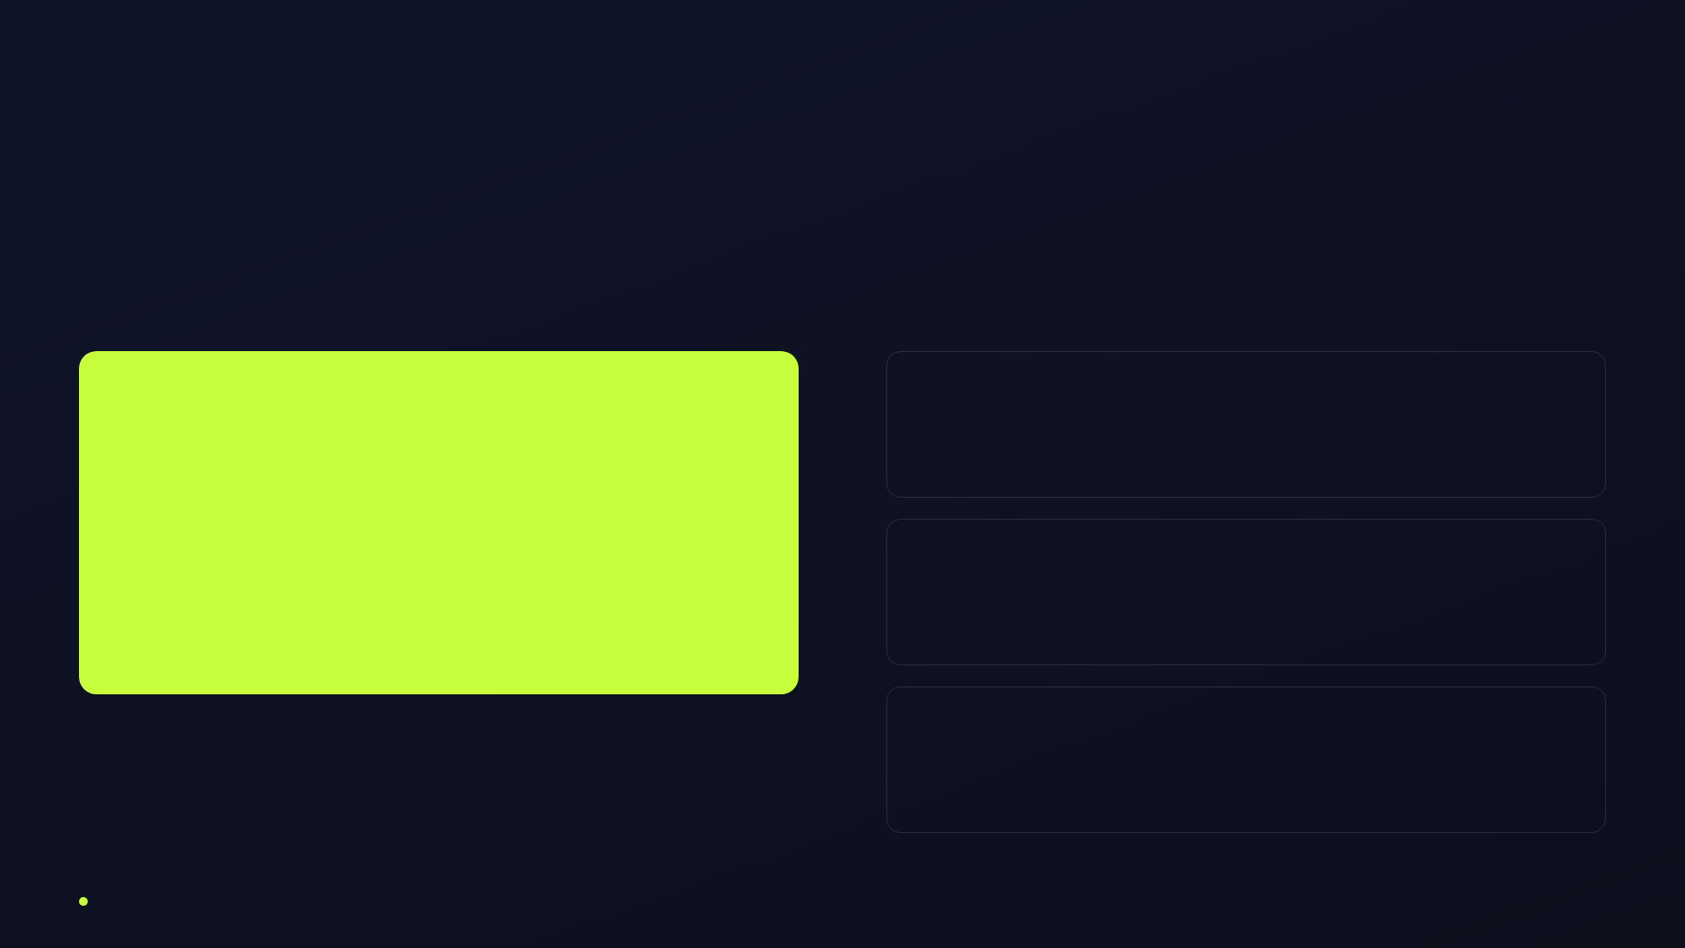
GOALS · Q3 TARGETS THAT DEFINE SUCCESS
One north star, three drivers.
NORTH STAR METRIC
Awareness
18%
Aided brand recall in target ICP
25K
Acquisition
120K
activated teams by Sept 30 — a team that
New signups from paid + organic
created a project and invited ≥2 members.
Conversion
8.5%
Free → paid within 30 days
Blended CAC ceiling:
$42
· Target LTV:CAC
3.4×
CADENCE
GOALS & TARGETS
03 / 11

Slide 4
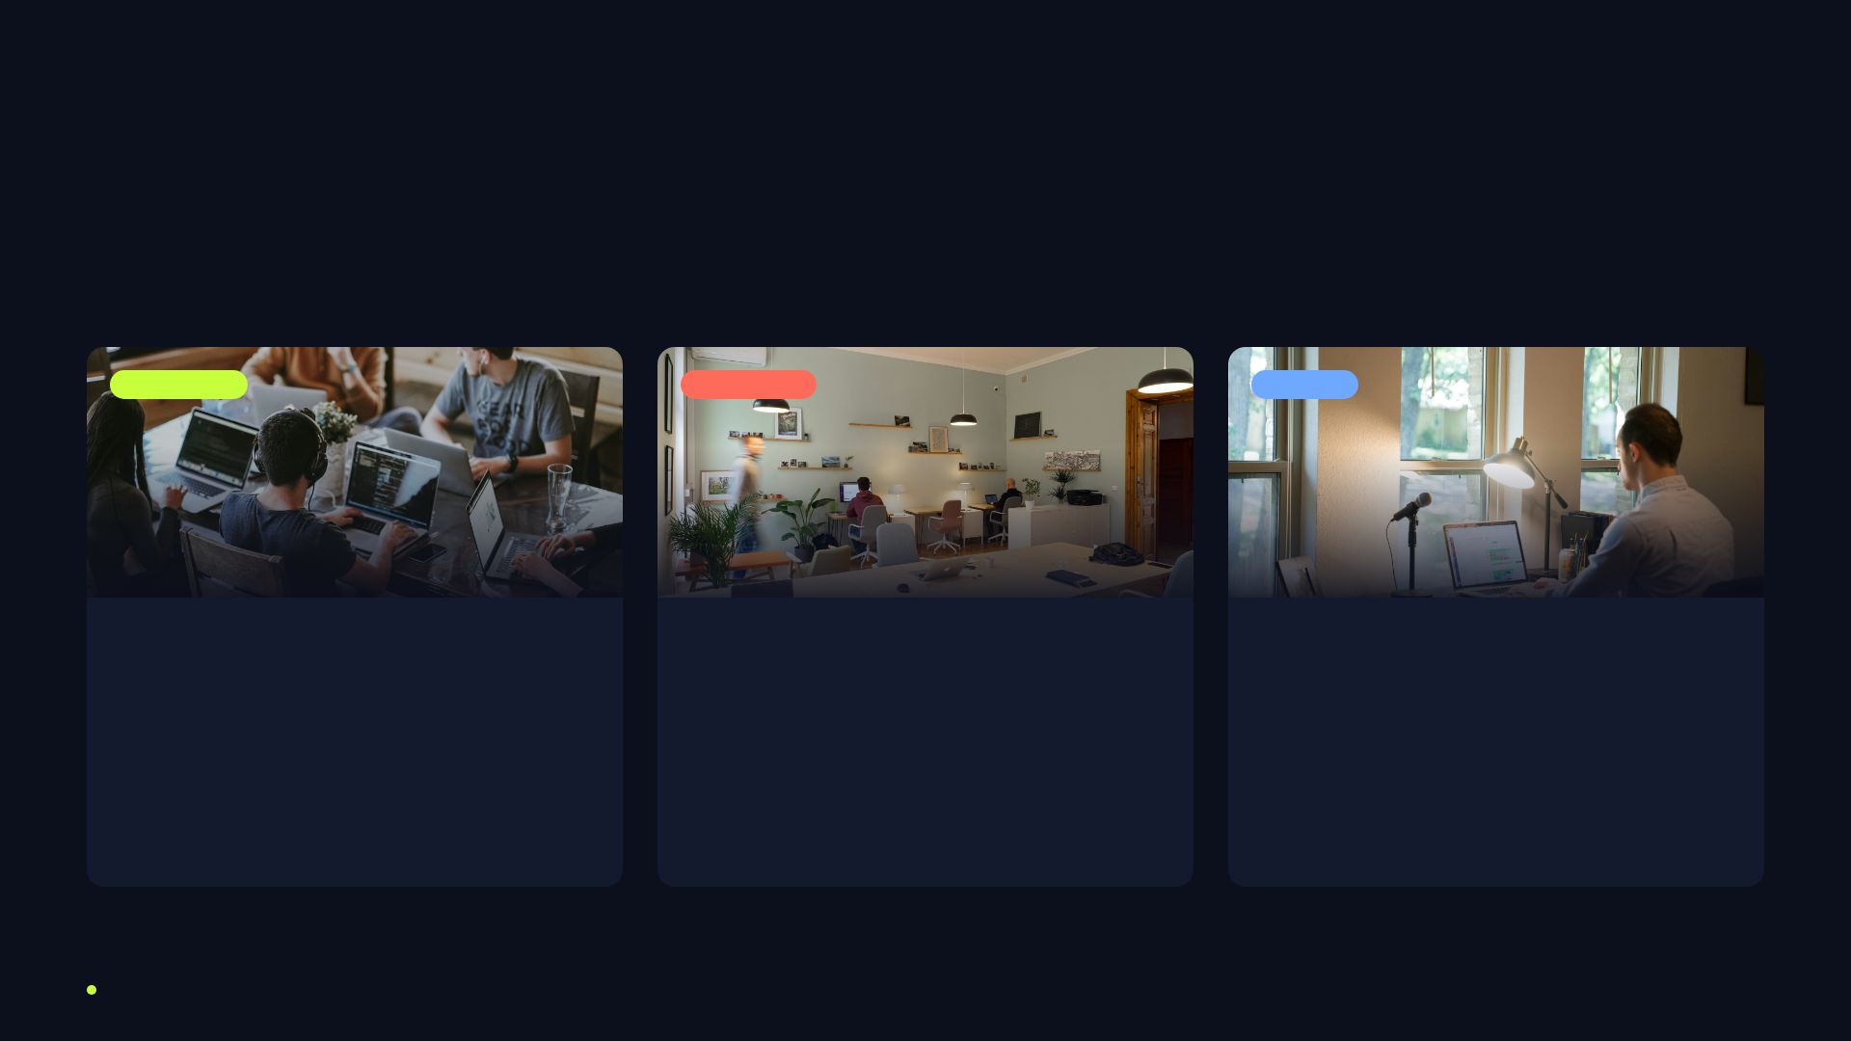
AUDIENCE · WHO WE'RE BUILDING THE RHYTHM FOR
Three teams, one need.
PRIMARY · 55%
GROWTH · 30%
SEED · 15%
Scaling Startups
Agencies
Solo & Micro
10–75 person product teams
Client-services & creative shops
Founders, freelancers, 1–5 people
Outgrew spreadsheets, hate enterprise bloat. Pain:
Many parallel projects, tight deadlines. Pain: client visibility
Fast to try, loud to share. Pain: too much overhead. Our free
coordination breaks the day they hit 20 people.
and utilization tracking.
tier's viral engine.
CADENCE
TARGET SEGMENTS
04 / 11

Slide 5
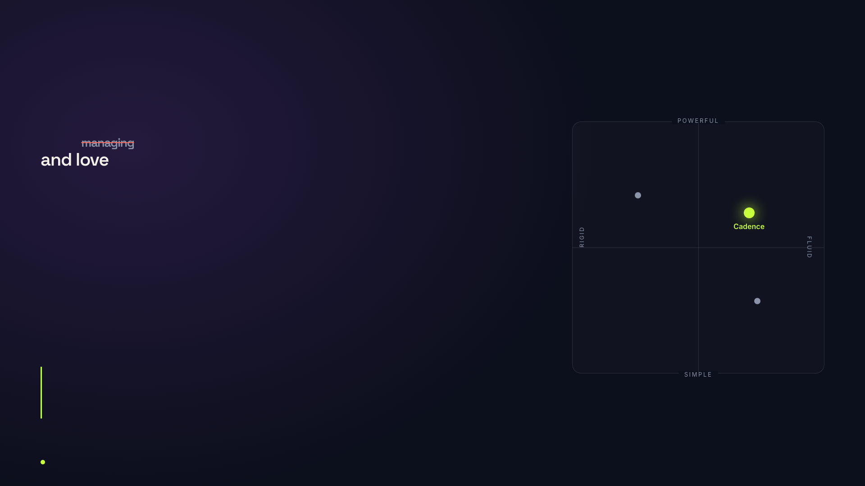
POSITIONING · THE ONE THING WE OWN
For teams that
hate
moving.
Asana
Trello
Cadence is the project-management app that stays out of the way.
While
competitors sell control, we sell momentum — set the beat once and let the
team keep time. Positioned against Asana's complexity and Trello's ceiling.
CADENCE
POSITIONING
05 / 11

Slide 6
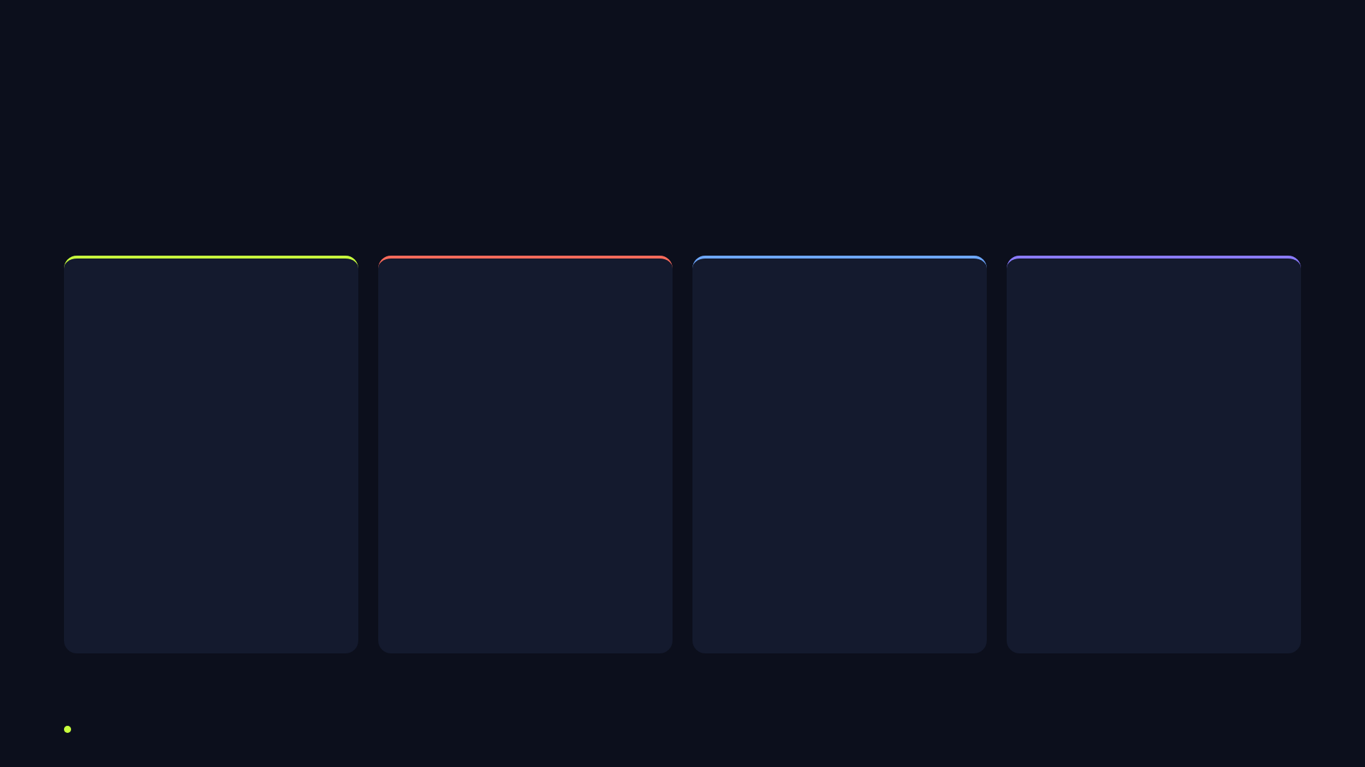
CHANNEL MIX · FOUR ENGINES, ONE FUNNEL
How we reach them.
01 / CONTENT
02 / PAID
03 / LIFECYCLE
04 / COMMUNITY
Earned Attention
Bought Reach
Owned Nurture
Shared Advocacy
SEO hub: "team ops" playbooks
Google intent search
5-step onboarding drip
Product Hunt launch day
Weekly "In Sync" newsletter
LinkedIn ABM to agencies
In-app activation nudges
Ambassador program
Founder POV on LinkedIn
Reddit + YouTube pre-roll
Trial→paid upgrade flow
Slack community "The Beat"
Template gallery (link-bait)
Retargeting sequences
Win-back for churned
Referral loop (2-sided)
Role · Top of funnel
Role · Acquisition
Role · Conversion
Role · Retention / loop
CADENCE
CHANNEL MIX
06 / 11

Slide 7
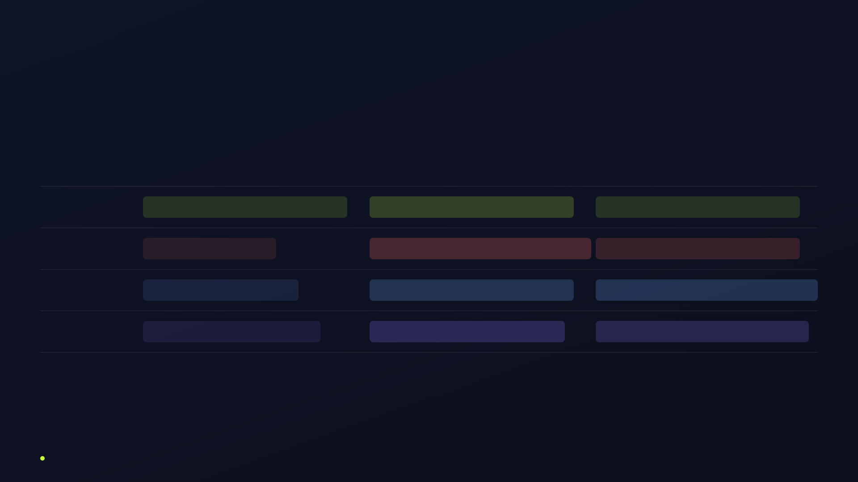
CALENDAR · THE Q3 BEAT SHEET
Three months, three acts.
JULY · TEASE
AUGUST · LAUNCH
SEPTEMBER · SCALE
Content
SEO hub build + teaser posts
Launch story + template drop
Customer stories, podcast tour
Paid
Waitlist ads
Full-spend blitz — search + social
Scale winners, ABM to agencies
Lifecycle
Waitlist warming
Onboarding drip live
Trial→paid + win-back flows
Community
Recruit ambassadors
Product Hunt launch day
Referral loop + Slack activation
★ Key moment · Aug 12 — Product Hunt + press embargo lifts
CADENCE
CAMPAIGN CALENDAR
07 / 11

Slide 8
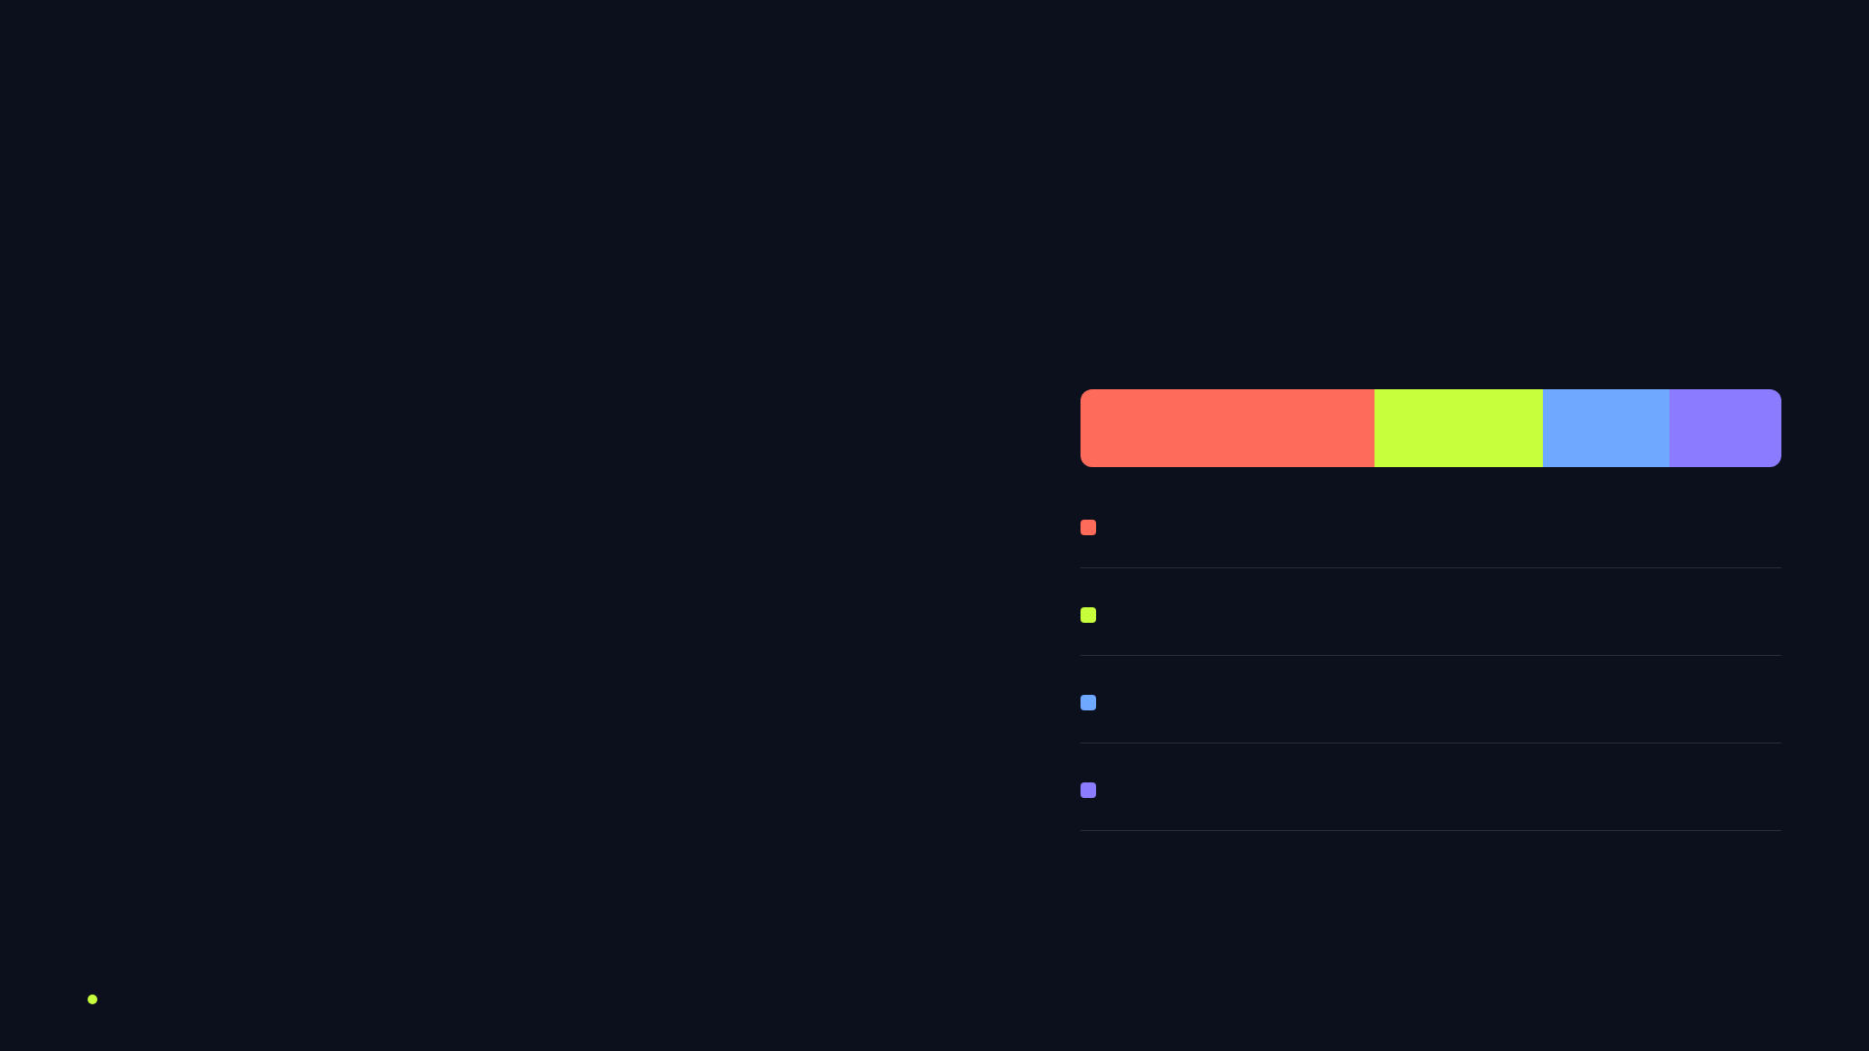
BUDGET · WHERE THE $600K GOES
Spend follows the funnel.
$600K
Paid acquisition
42%
· $252K
Content & SEO
24%
· $144K
total Q3 marketing budget · 68% variable / 32% fixed
Lifecycle & tooling
18%
· $108K
Community & events
16%
· $96K
CADENCE
BUDGET ALLOCATION
08 / 11

Slide 9
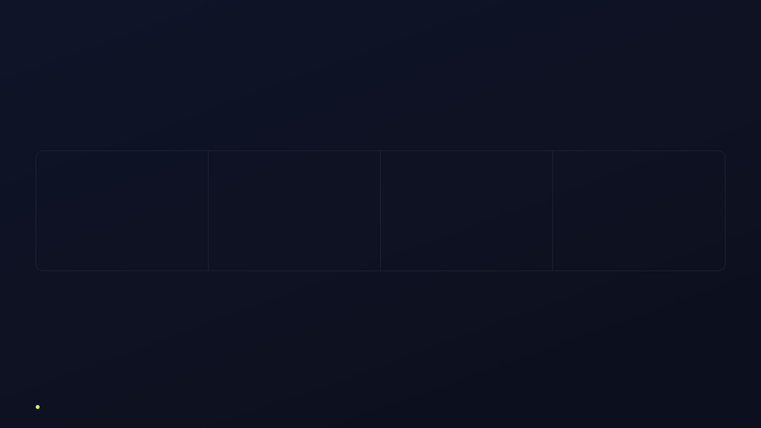
METRICS · HOW WE'LL KNOW IT WORKED
Measured by the beat.
AWARENESS
ACQUISITION
ACTIVATION
REVENUE
Impressions / SOV
Signups / CAC
Teams activated
New MRR
40M
120K
25K
$310K
tracked weekly · dash
CAC ≤ $42 blended
north star
8.5% free→paid
CADENCE
KILL SWITCH
SOURCE OF TRUTH
Weekly growth review · Monday
Pause any channel under 2× ROAS at wk 4
Amplitude + HubSpot + Looker
CADENCE
SUCCESS METRICS
09 / 11

Slide 10
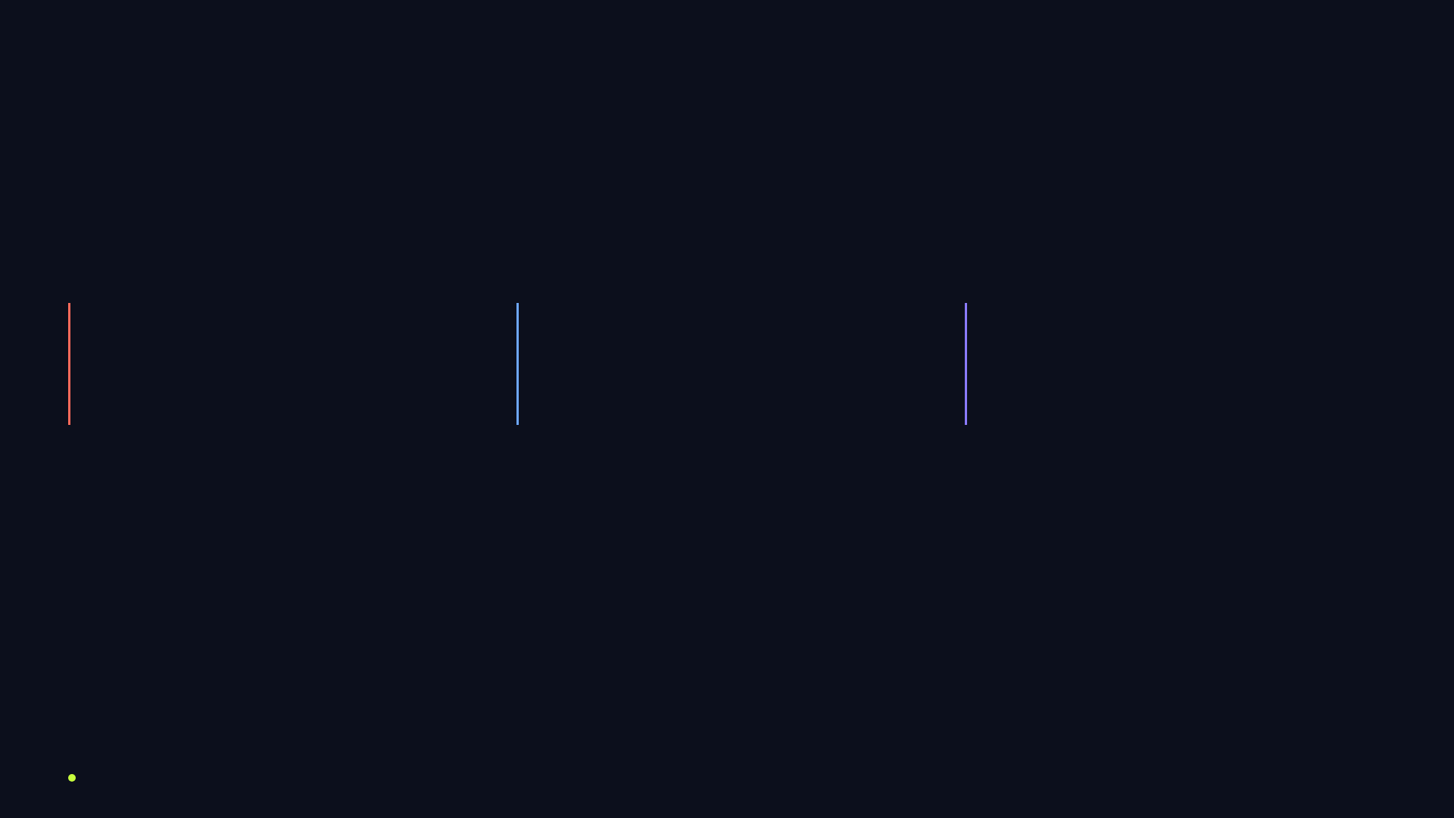
RISKS · WHAT COULD BREAK THE RHYTHM
Planned for, not hoped away.
Paid CAC spikes
Weak activation
Launch-day noise
Auction inflation on launch keywords.
Signups don't invite teammates.
Product Hunt gets buried.
Mitigation:
weight budget to owned SEO + referral loop;
Mitigation:
onboarding drip + in-app nudges shipped
Mitigation:
pre-warmed ambassador list + hunter secured
cap CAC at $42 with auto-pause.
before paid ramp; templates lower time-to-value.
3 weeks out; press embargo synced.
CADENCE
RISKS & MITIGATION
10 / 11

Slide 11

THE ASK · WHAT WE NEED TO HIT GO
Approve the beat.
$600K, twelve weeks, four channels, one north star:
25,000
activated teams by Sept 30.
Green-light by June 20 to lock the
July tease and hold the Aug 12 launch date.
DECISION BY
LAUNCH DAY
TARGET MRR
June 20
Aug 12
$310K
CADENCE
LET'S SHIP IT
11 / 11

