Slide 1

Exploring a
calmer digital
experience.
Fictional generated example for Juniper Vale Health Labs ·
junipervale.example. This is not a medical device, treatment,
SAMPLE
regulatory submission, investment offer, or evidence of
efficacy.
ILLUSTRATIVE · NOT AN OFFER

Slide 2

A sample brief can frame
a wellness concept.
SAMPLE
Illustrative narrative only.
Juniper Vale Health Labs
has no patients, clinical
program, care delivery, or
treatment claims.
SAMPLE
SAMPLE
illustrative context, not market
no prescribing, treatment, or
research or a health claim
clinical recommendation is
represented
THE PROBLEM
02 / 11

Slide 3

Three curves just crossed —
and the window is open.
S
A
M
Sample product framing
Sample concept direction
Sample audience note
Illustrative consumer-technology context; no shipment, adoption,
This example has no regulatory status, clearance,
No payer, insurer, billing code, contract, or reimbursement
or market claim is made.
authorization, reimbursement pathway, or clinical use.
relationship is represented.
WHY NOW
03 / 11

Slide 4
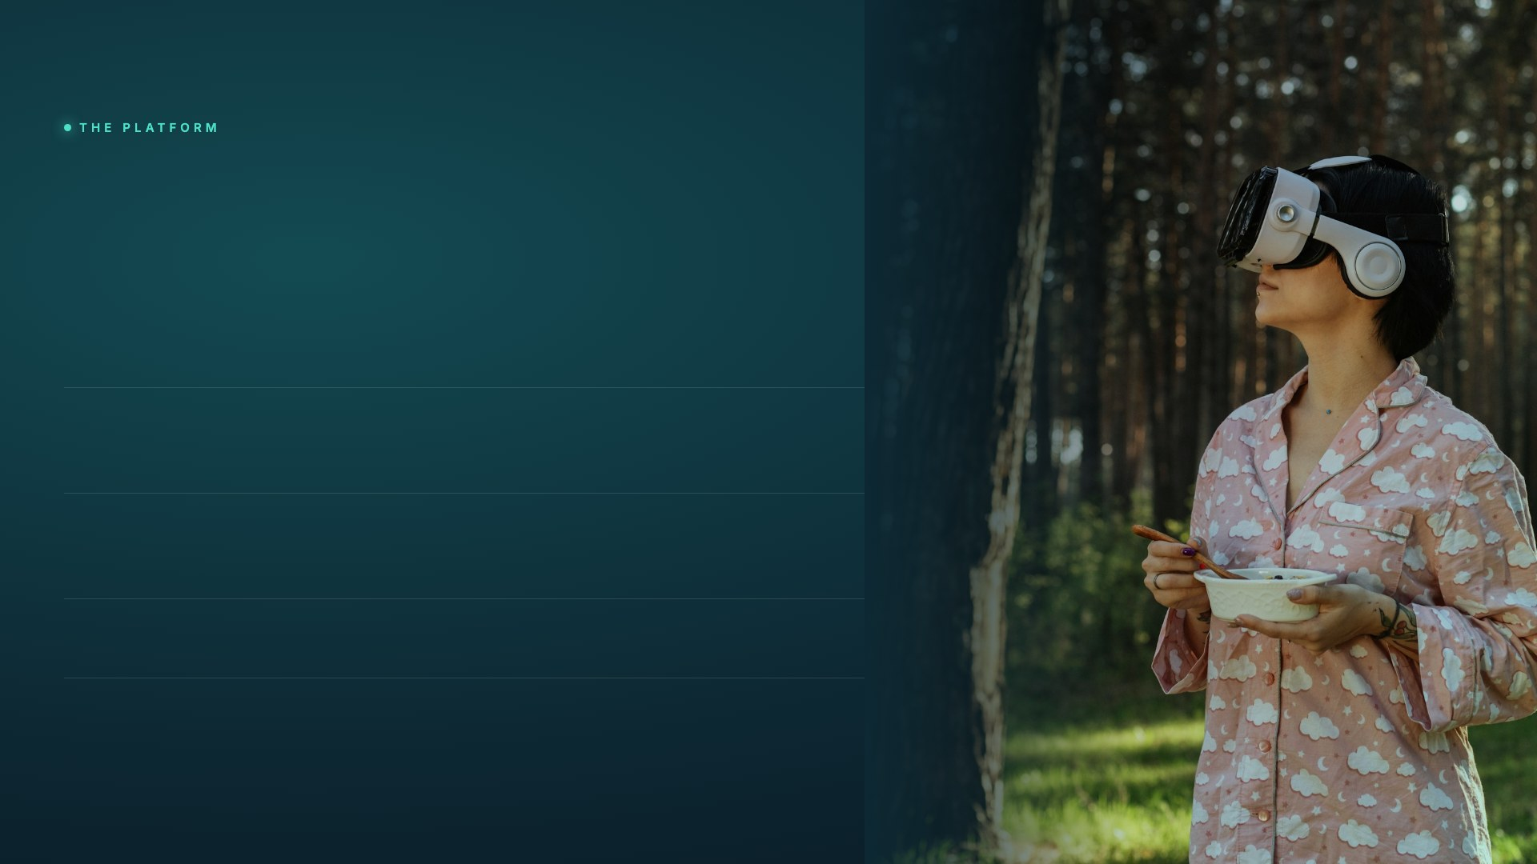
Juniper Vale Health Labs presents
a wellness-interface
layout concept.
An illustrative VR interface for product-storytelling practice. It is
not prescribed, clinical, therapeutic, or intended to affect health
outcomes.
01
Illustrative scenes
Sample visual modules created solely to demonstrate a presentation
layout.
02
Interface exploration
No clinical data, patient treatment, provider workflow, or measured
outcome exists.
03
Fictional example
Not prescribed, reimbursable, billed, cleared, or authorized for any use.
THE SOLUTION
04 / 11

Slide 5
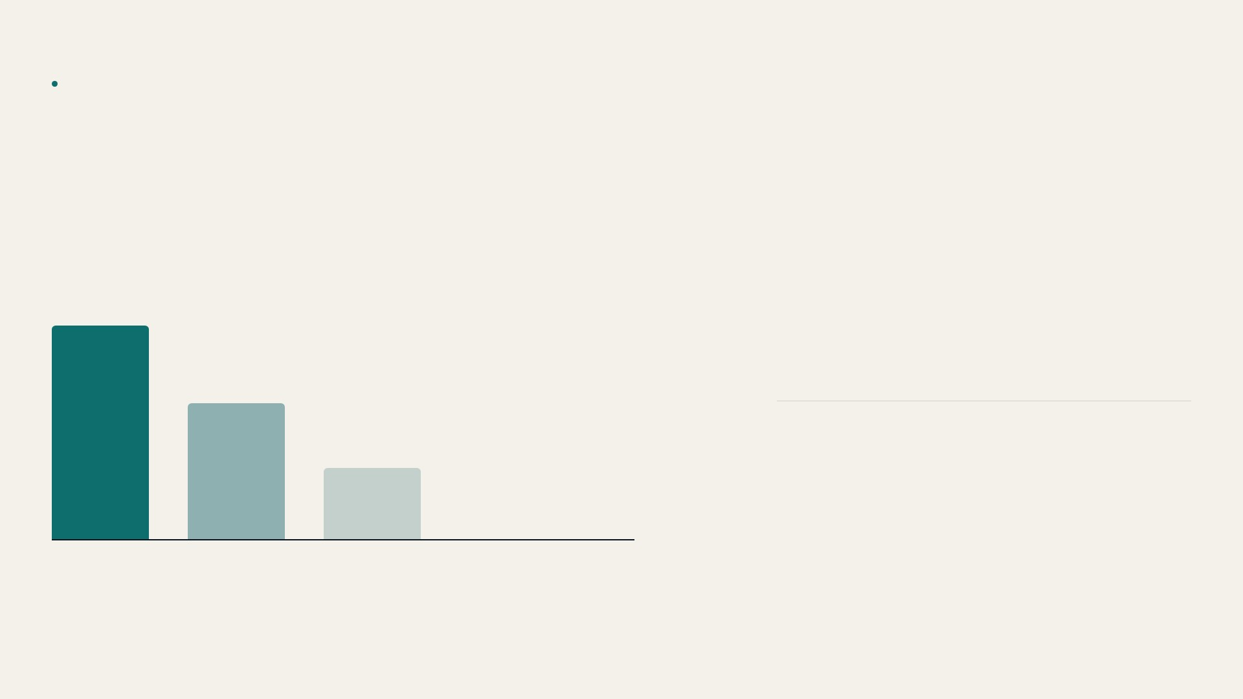
FICTIONAL SAMPLE METRICS
How an illustrative
comparison might look.
SAMPLE
SAMPLE
This chart is a design illustration. No randomized
trial, study, participant, efficacy result, or clinical
outcome exists.
SAMPLE
SAMPLE
0
0
N/A
studies represented
participants represented
outcomes represented
Illustrative
Illustrative
Illustrative
concept
alternative
baseline
ILLUSTRATIVE CHART TREATMENT · NOT STUDY DATA OR AN OUTCOME MEASURE
VALIDATION
05 / 11

Slide 6

A presentation layout
for sample planning.
ILLUSTRATIVE PLANNING CURVE · NOT REVENUE
SAMPLE
0
illustrative planning figure
patients, deployments, or pilots
represented
SAMPLE
0
not revenue, ARR, or a contract claim
payer agreements or affiliations
represented
Q1'24
Q2
Q3
Q4
Q1'25
Q2'25
Illustrative relationships
No deployments, endorsements, pilots, payer agreements, clinical affiliations, or commercial relationships are represented.
TRACTION
06 / 11

Slide 7

A sample market
SAMPLE TAM
storyboard.
SAMPLE SAM
SAMPLE
ILLUSTRATIVE ONLY
SAMPLE
Broad context.
A placeholder for a future, independently
sourced market view.
SAMPLE
Focused context.
A layout placeholder, not a market-size
or care claim.
SAMPLE
Illustrative segment.
No forecast, treatment, prescribing,
or growth claim is made.
MARKET
07 / 11

Slide 8
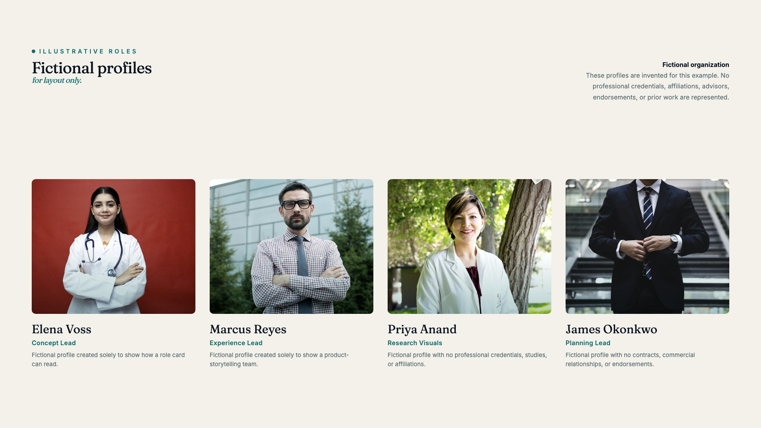
TEAM
08 / 11

Slide 9

SAMPLE PLANNING CATEGORIES
SAMPLE
40%
Experience exploration
Product concepts
25%
Presentation-only planning allocation. Not an investment offer, solicitation,
valuation, or funding request.
Illustrative outreach
20%
Team planning
15%
Exploration
Product
Outreach
Team
Illustrative 24-month planning horizon
THE ASK
09 / 11

Slide 10

A sample sequence
for a concept deck.
Q2
Q4
'27
'26
'26
Experience concept
Design review
Sample future state
Create illustrative interface studies. No clinical study, participant
Review a fictional narrative and visual system. No
A placeholder for future design exploration, not a revenue forecast,
enrollment, or regulatory submission is planned or represented.
authorization, coverage, payer agreement, or commercial
investment round, deployment plan, or patient-care claim.
relationship is represented.
MILESTONES
10 / 11

Slide 11

Juniper Vale Health Labs
· Fictional organization
hello@junipervale.example
junipervale.example
A fictional layout
for demonstration.
Fictional generated example · No medical, regulatory, investment, payer, deployment, or affiliation claim

