Slide 1

Meet
Relay.
The AI note-taker that lives inside your chat.
Every
meeting, captured, decided, and shipped to the right
channel — before anyone opens a doc.
01 / 09

Slide 2

62%
Meetings end.
The memory
walks out
of decisions never leave the call
the door.
Someone volunteers to "send notes." They don't. Action
items scatter across five DMs, three heads, and zero follow-
through. Knowledge evaporates the moment the call drops.
02 / 09

Slide 3

WHY NOW
The work moved
to chat. The
notes
never followed.
71%
3.1×
0
Async by default
AI got trustworthy
Extra tools tolerated
Teams now run more decisions through chat threads
Transcription and summarization accuracy tripled in two
No one wants a fourth app. The winning notetaker is the
than live meetings — but recall still relies on memory.
years. Notes are finally good enough to act on.
one already in the workspace.
03 / 09

Slide 4
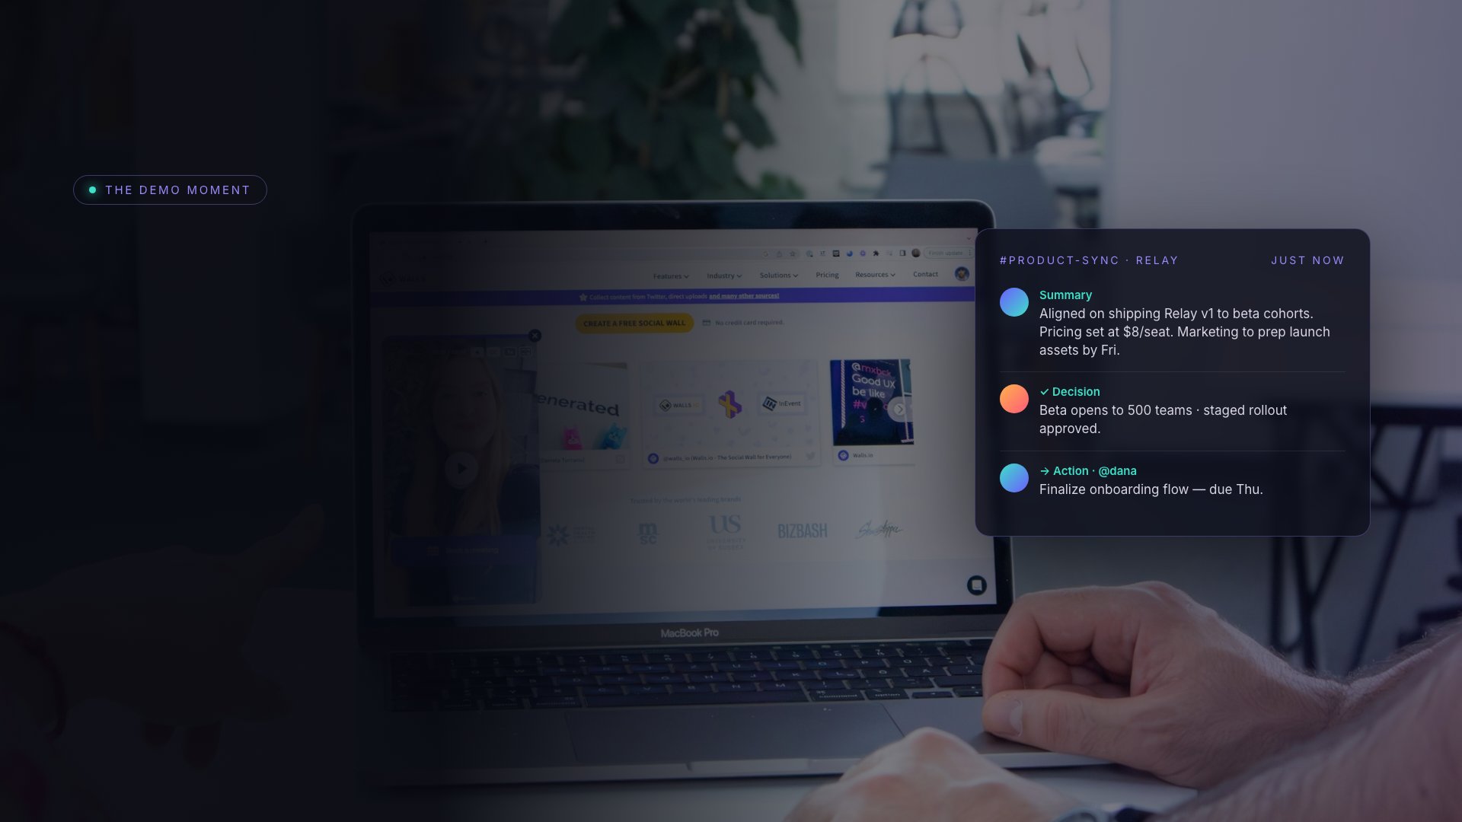
Call ends.
Notes are
already
in the channel.
Relay joins any huddle, listens, and the instant you
hang up it drops a clean recap — summary,
decisions, owners, and due dates — right where the
team already talks.
04 / 09

Slide 5
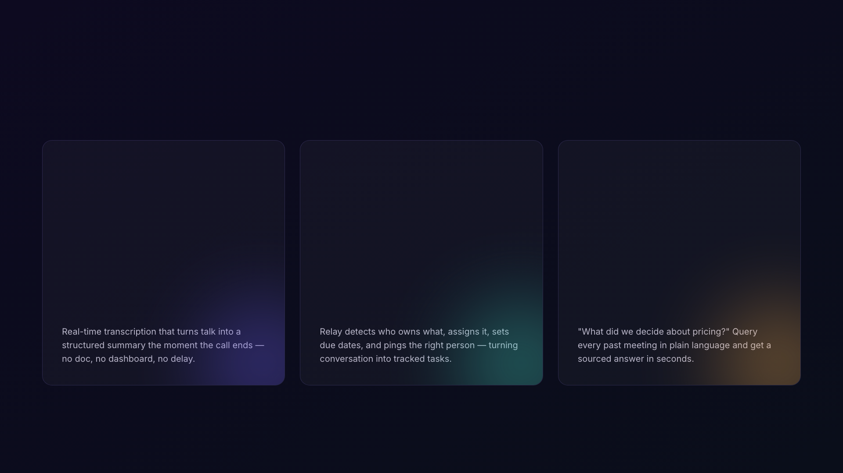
THREE HEADLINE CAPABILITIES
What Relay
actually does.
01
02
03
Live Recap
Action Router
Ask Anything
05 / 09

Slide 6

BUILT FOR
Teams that decide
fast and forget
faster.
Fast-moving startups
Product & eng squads
Remote-first orgs
Client-facing teams
Ship decisions without a scribe.
Standups that document themselves.
Async recall across time zones.
Never lose a promise made on a call.
06 / 09

Slide 7
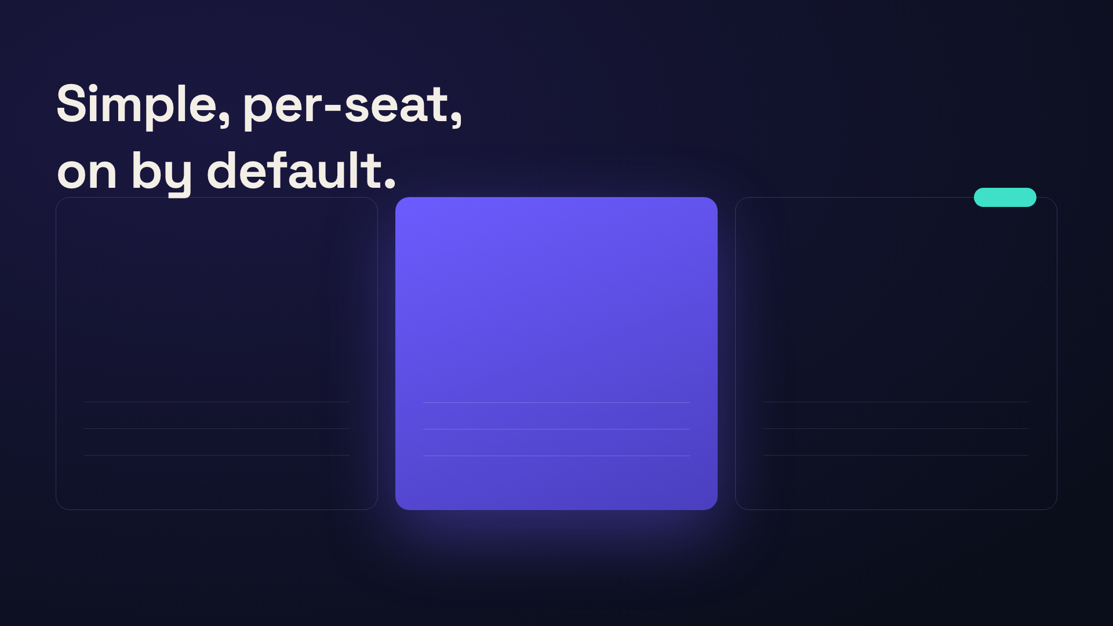
PRICING & AVAILABILITY
LAUNCH
STARTER
PRO
ENTERPRISE
$0
$8
Custom
/seat
/seat / mo
Free for teams under 10. Get the habit going.
Everything a growing team needs to never lose a
SSO, admin controls, and data residency at scale.
decision.
Live recaps
Action Router + owners
SOC 2 · SSO/SCIM
7-day history
Ask Anything, unlimited
Retention controls
Up to 10 seats
Unlimited history
Priority support
07 / 09

Slide 8

ROLLOUT TIMELINE
From beta to
everywhere
in one quarter.
NOW
MAR
MAY
Q3
Private Beta
Open Beta
General Availability
Platform
500 hand-picked teams stress-testing
Waitlist opens to all Pro workspaces.
Relay switches on for every plan,
Integrations API + Enterprise controls
Live Recap and Action Router.
Ask Anything ships.
default across the app.
and data residency.
08 / 09

Slide 9

Stop taking notes.
Start
shipping
decisions.
Relay is live in beta today. Flip it on in your workspace
and never lose a meeting again.
relay.app/launch
© 2025 RELAY
09 / 09

