Slide 1

BRAND REFRESH · CONFIDENTIAL PROPOSAL
Pour a
new
first sip.
PREPARED FOR
A complete brand refresh for a beloved regional coffee
ALDERQUILL COFFEE CO.
chain — from identity and packaging to the in-store
PREPARED BY
experience. Eight weeks, one clear system, a warmer
ROAST & RISE STUDIO
welcome.
ROAST & RISE STUDIO
01 / 10

Slide 2
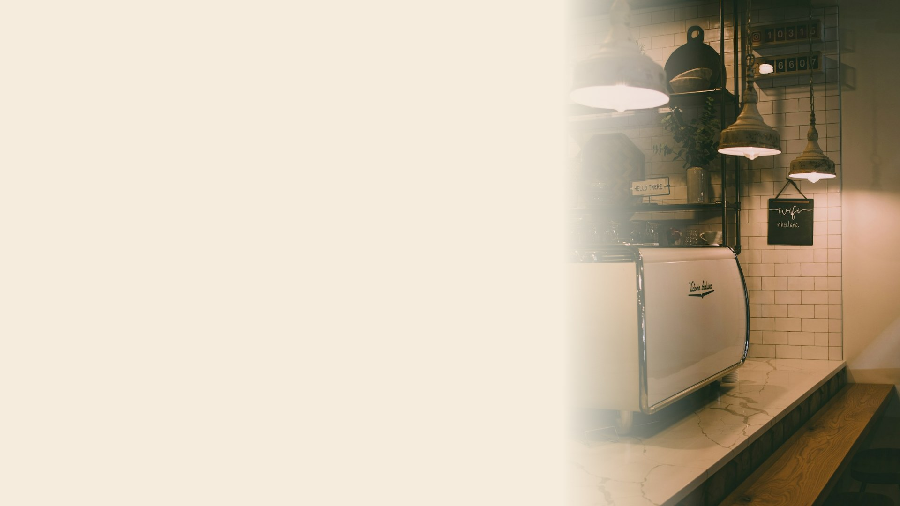
01 — THE OBJECTIVE
Loved locally.
Blurry
everywhere else.
Alderquill has grown to 34 cafés on loyalty and
great coffee — but the brand has drifted. Six logo
variants, three cup designs, and signage that no
longer says who you are.
34
6
41%
CAFÉS, ONE REGION
CONFLICTING LOGOS
CAN'T RECALL THE BRAND
02 / 10

Slide 3

02 — WHY NOW
The window is open.
A refresh
now
compounds.
Expansion is coming
A new generation
Packaging pivot
12 new locations are planned across the next 18
Gen-Z regulars discover cafés through the feed first.
A retail bagged-bean line launches in Q3 — the
months. Every one built on the current mess
The brand needs to photograph as well as it pours.
perfect moment to define one coherent look
multiplies the cleanup cost.
on the shelf.
"Do it once, do it right, before the footprint doubles."
03 / 10

Slide 4

03 — OUR APPROACH
Four steps,
brewed in order.
01
02
03
04
Discover
Define
Design
Deploy
Audit the current identity, interview staff
Positioning, voice and a single strategic
Identity system, packaging, signage and
Guidelines, asset handoff and a rollout plan
& regulars, map the competitive shelf.
platform to design against.
the full expression across touchpoints.
across all 34 locations.
04 / 10

Slide 5

04 — SCOPE & DELIVERABLES
What you'll
Identity System
Packaging Suite
hold in hand.
Primary logo, marks, color, type & a full lockup family.
Cups, sleeves, bagged-bean line & retail labels.
In-Store Experience
Digital Kit
Signage, menu boards, wayfinding & interior accents.
Social templates, app icon, email & web headers.
Brand Guidelines
Rollout Playbook
A living 60-page book for teams & vendors.
Phased plan & asset packs for all 34 locations.
Out of scope:
Photography shoot day (add-on)
Print production & installation
Ongoing social management
05 / 10

Slide 6

05 — TIMELINE
Eight weeks,
start to shelf.
W1
W2
W3
W4
W5
W6
W7
W8
Discover
Define
Design
Deploy
◆
Milestone 1
— Strategy sign-off · W2
◆
Milestone 2
— Identity review · W5
◆
Milestone 3
— Final handoff · W8
06 / 10

Slide 7

06 — THE TEAM
Five hands
on the roast.
Nadia Owusu
Léo Marchand
Priya Anand
Sam Ríos
CREATIVE DIRECTOR
BRAND STRATEGIST
LEAD DESIGNER
PACKAGING & 3D
07 / 10

Slide 8

07 — THE INVESTMENT
Fair price,
full flavor.
Discover & Define
$14,000
TOTAL ENGAGEMENT
$78k
Identity & Packaging Design
$32,000
In-Store & Digital Kit
$18,000
Fixed fee · 8-week engagement
Guidelines & Rollout
$14,000
50% on kickoff · 50% at final handoff. Photography day & production quoted
separately.
08 / 10

Slide 9

08 — NEXT STEPS
Three sips
to kickoff.
1
Approve this proposal
Countersign & return by
May 3
to hold the summer window.
2
Kickoff workshop
Half-day session with your leadership to align on goals & access.
3
We start brewing
Discovery begins the following Monday. First readout in two weeks.
09 / 10

Slide 10

LET'S BUILD THE NEXT CHAPTER
Same beans.
Bolder brand.
Nadia Owusu · Creative Director
nadia@roastandrise.studio
· +1 503 555 0147
roastandrise.studio
ROAST & RISE STUDIO · PROPOSAL VALID 30 DAYS
10 / 10

