Slide 1

A 90-DAY GROWTH PROGRAM · PREPARED FOR LUMÉ SKINCARE
Break the
plateau.
Grow again.
You've built a beautiful brand and a loyal base. Now let's turn that
Brightwork
foundation into a compounding growth engine — in one focused
Growth Marketing
quarter.
CONFIDENTIAL PROPOSAL
01

Slide 2

THE PLATEAU
Great product.
Flat
growth curve.
Revenue that grew 4× in your first two years has settled into single-digit monthly
gains. Paid acquisition costs keep climbing, your best channel is saturated, and
repeat-purchase rates have stalled. The engine that got you here won't get you to
the next level.
%
-38
DECLINE IN BLENDED ROAS OVER THE
LAST THREE QUARTERS — THE
PLATEAU, IN ONE NUMBER.
THE PROBLEM
02

Slide 3

WHY NOW
The window to move
is open — but narrowing.
01
02
03
Rising CAC won't wait
Retention is untapped
Category demand is peaking
Meta and Google CPMs are up double digits year over year. Every
Your repeat customers spend 3× more than first-timers, yet
Clean-skincare search interest is at an all-time high. Capturing that intent
month you delay, acquisition gets more expensive and harder to
lifecycle marketing is barely automated. This is unearned revenue
now compounds; waiting hands it to competitors.
reverse.
sitting on the table.
WHY NOW
03

Slide 4

OUR APPROACH
One quarter.
One
growth
engine.
90
DAYS TO MOMENTUM
We don't sell retainers that run forever. We install a full-funnel
growth system — acquisition, conversion, and retention working
together — and prove it in 90 days with hard numbers.
THE SOLUTION
04

Slide 5

THE PLAYBOOK
How the 90 days unfold.
Phase 01
Phase 02
Phase 03
Phase 04
Diagnose
Build
Scale
Hand off
Full-funnel audit, data instrumentation, and customer
New creative testing, landing-page overhaul, and a
Aggressive test-and-learn across channels, doubling
Documented playbook, dashboards, and a scaling
research to find the leaks and the fastest wins.
lifecycle email/SMS engine wired to your store.
down on winners and killing waste weekly.
roadmap so momentum outlives the engagement.
DAYS 1–15
DAYS 16–45
DAYS 46–75
DAYS 76–90
THE PLAYBOOK
05

Slide 6
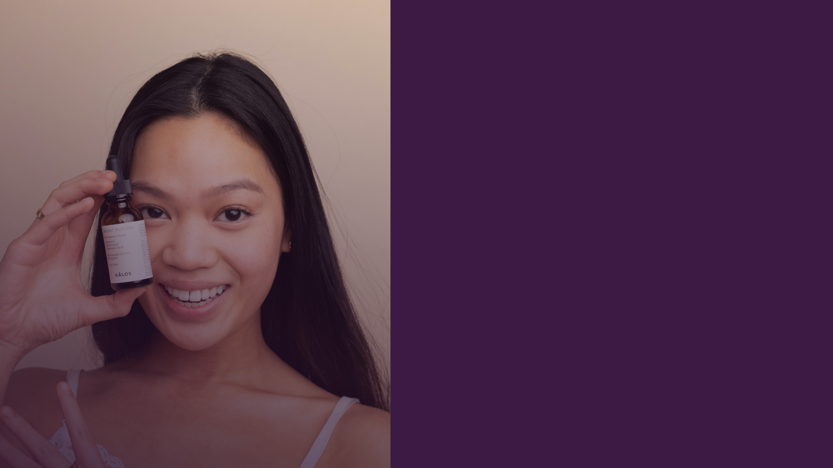
CASE STUDY 01 — HALO BOTANICALS
A stalled DTC brand,
back on the curve.
2.4
+61
×
%
BLENDED ROAS IN 90 DAYS
REPEAT PURCHASE RATE
$1.8
M
INCREMENTAL REVENUE ATTRIBUTED TO THE PROGRAM
"Brightwork found revenue we didn't know we were
losing — and turned it back on in six weeks."
— VP GROWTH, HALO BOTANICALS
PROOF
06

Slide 7

CASE STUDY 02 — VERVE SKIN CO.
From flat to
compounding.
Verve had plateaued at $220K/month for three quarters. We
rebuilt their creative testing engine and launched a lifecycle
program. Monthly revenue nearly doubled by day 90 — and
kept climbing after handoff.
1.9×
-34%
4.6×
MONTHLY REVENUE
BLENDED CAC
EMAIL REVENUE
PROOF
07

Slide 8

WHY BRANDS TRUST BRIGHTWORK
Across 40+ DTC brands,
the numbers repeat.
3.2
40
-29
92
×
+
%
%
Median revenue lift within a single 90-day program
DTC and beauty brands scaled since 2019
Average reduction in blended acquisition cost
Of clients renew or expand after the first program
TRACK RECORD
08

Slide 9

PROGRAM PACKAGES
Pick your
MOST POPULAR
Accelerate
Ignite
$32K
$18K
PER MONTH · 90 DAYS
PER MONTH · 90 DAYS
Everything in Ignite
Full-funnel audit & roadmap
Lifecycle email & SMS engine
Paid social + search management
Landing-page & CRO overhaul
Bi-weekly creative testing
Weekly test-and-learn sprints
Monthly reporting
Live dashboard + Slack access
INVESTMENT
09

Slide 10

NEXT STEPS
Let's start
the
90 days.
1
Book a 45-minute growth diagnostic this week — no
cost, no commitment.
2
We deliver a tailored plateau-breaking roadmap
within 5 business days.
3
Choose your package and kick off — first results by
day 30.
Ready when you are.
hello@brightwork.co · brightwork.co
LET'S GROW
10

